Slide 1


Vector Databases: A Deep Dive
This presentation delves into the world of vector databases, exploring their core concepts, applications, and future implications.
by Sahil Wani
SUID: 466848553

Slide 2
Agenda
Introduction to Vector Databases
What are Vector Databases?
Comparing Vector Databases with Traditional Databases
Why Vector Databases?
Core Components of Vector Databases
How Vector Database Works
Key Features
Use Cases
Vector Database Solutions
Advantages
Challenges and Considerations
Future Trends

Slide 3

Introduction to Vector Databases
In today's data-driven world, traditional databases are struggling to keep up with the demands of modern applications. Enter Vector Databases, a new breed of data storage solutions that leverage the power of vector embeddings to revolutionize how we store and retrieve information.

Slide 4
What are Vector Databases?
Understanding Vector Databases
The Power of Vectors
Vector Databases are a type of database that stores and retrieves data based on its similarity to other data points. Unlike traditional databases that rely on structured data and keywords, Vector Databases use vector representations of data, enabling them to understand the meaning and relationships between different data points.
Imagine a database that can understand the nuances of human language, the similarity of images, or the relationships between different products. Vector Databases achieve this by converting data into numerical vectors, allowing for complex comparisons and search queries that go beyond simple keyword matching.

Slide 5
Comparing Vector Databases to Traditional Databases
Traditional Databases
1
Store data in structured tables with rows and columns.
Vector Databases
2
Store data as vectors, enabling similarity search and understanding data relationships.
Traditional Databases
3
Relies on keywords and exact matches for retrieval.
Vector Databases
4
Supports semantic search and understanding the meaning of data.

Slide 6

Why Vector Databases?
1
The rise of AI and machine learning technologies has driven the adoption of Vector Databases. These databases are particularly well-suited for handling complex data like images, audio, and text, which are often challenging for traditional relational databases.
2
The ability of Vector Databases to handle semantic search and understand the relationships between data points has made them increasingly popular in applications like recommendation systems, image search, and natural language processing.
3
The emergence of specialized Vector Databases like Pinecone, Weaviate, and Milvus has further accelerated the growth of this technology, providing developers with dedicated tools and resources to build sophisticated AI-powered applications.

Slide 7



Core Components of Vector Databases
Vector Embeddings
1
Converting data into numerical representations (vectors) that capture its meaning.
Indexing Mechanisms
2
Organizing vectors efficiently for fast similarity search and retrieval.
Search/Retrieval Methods
3
Algorithms for finding vectors that are most similar to a given query vector.

Slide 8
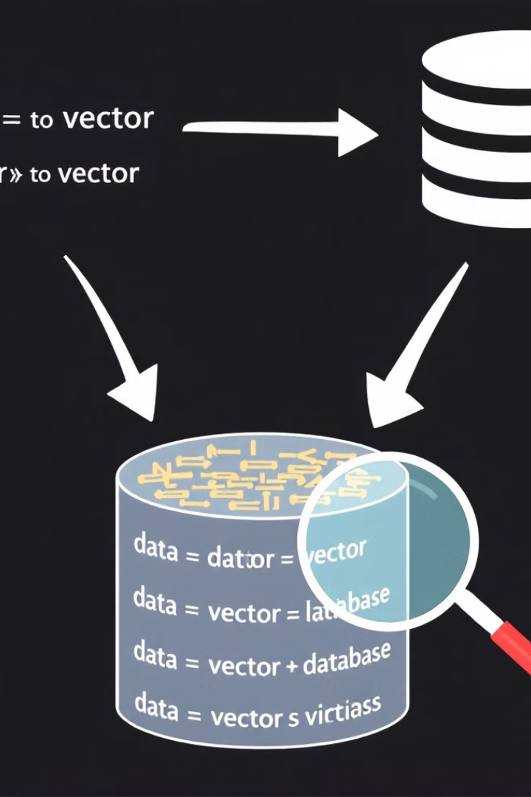




How Vector Databases Work
Data Ingestion
Raw data is ingested into the Vector Database.
Vector Embeddings
Data is transformed into numerical vectors using machine learning algorithms.
Index Creation
Vectors are organized and indexed for efficient similarity search.
Query Processing
Queries are converted into vectors, and the database retrieves the most similar vectors based on proximity.

Slide 9

Key Features of Vector Databases
Similarity Search
High Dimensionality
Vector Databases excel at finding data points that are similar to a given query, regardless of the specific keywords used.
They can handle data with many dimensions, allowing for complex relationships and fine-grained comparisons.
Scalability and Performance
Flexibility
They can work with various data types, including text, images, audio, and even custom data structures.
Vector Databases are designed to handle large datasets and provide fast query execution, making them suitable for real-time applications.

Slide 10

Use Cases for Vector Databases
Recommendation Systems
Image Search
Finding similar images based on visual content, rather than textual descriptions.
Providing personalized product recommendations based on user preferences and past behavior.
Natural Language Processing
Fraud Detection
Identifying suspicious patterns in financial transactions by analyzing similarities between different transactions.
Understanding the semantic meaning of text and performing tasks like sentiment analysis and question answering.

Slide 11

Popular Vector Database Solutions
Pinecone
Weaviate
Milvus
FAISS
A cloud-native vector database designed for speed and scalability, offering a range of features like similarity search, filtering, and metadata indexing.
A vector database with a strong emphasis on semantic search and knowledge graph capabilities, allowing for more nuanced and intelligent data retrieval.
An open-source vector database that excels in handling large-scale datasets and offering high-performance similarity search, often used for image and video applications.
A Facebook AI Similarity Search library that provides efficient and scalable similarity search algorithms, especially useful for image retrieval and recommendation systems.

Slide 12
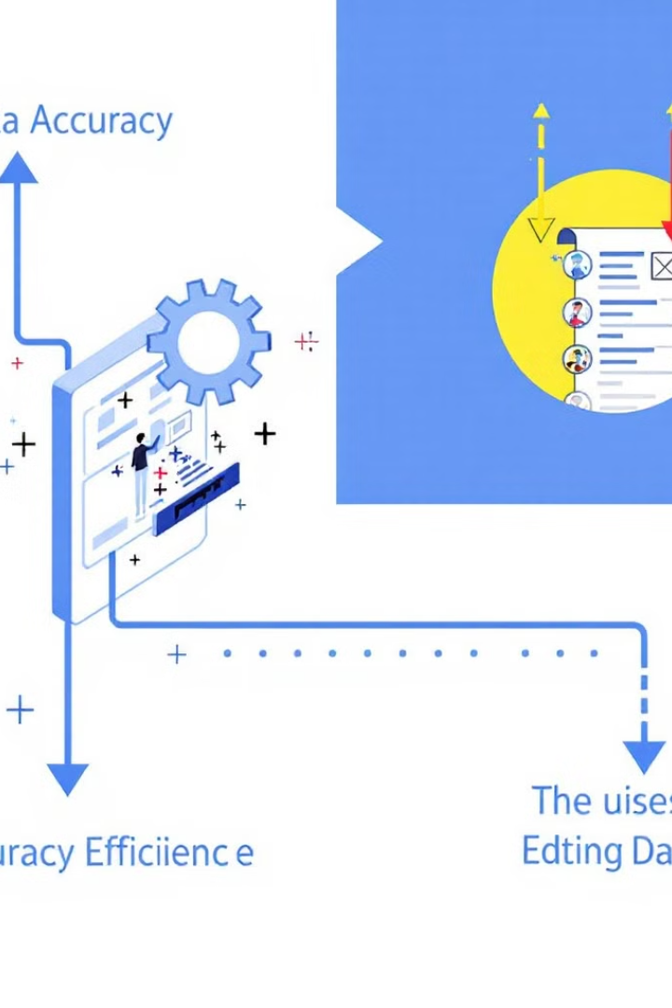


Advantages of Vector Databases
Improved Accuracy
By understanding the semantic meaning of data, Vector Databases provide more accurate search results and insights.
Enhanced Efficiency
They enable faster and more efficient data retrieval, leading to better performance for applications.
Enhanced User Experience
Delivering more relevant and intuitive search results, leading to a better user experience.

Slide 13

Challenges and Considerations
1
2
3
Vector Embeddings
Scalability
Data Privacy
Choosing the right embedding model is crucial for accurate similarity search.
Handling large datasets and ensuring fast query execution can be challenging.
Protecting sensitive data is essential, especially when working with user-generated content.

Slide 14



Future Trends in Vector Databases
Advanced Indexing
Continued development of indexing algorithms to handle even larger datasets and improve search performance, including techniques like approximate nearest neighbor search.
1
Hybrid Databases
2
Integration of vector databases with traditional relational databases to combine the strengths of both, offering a more comprehensive data management solution.
Industry Adoption
3
Increasing adoption across various industries, from e-commerce and healthcare to finance and education, driving innovation and efficiency in data-driven applications.

Slide 15


